Slide 1
Irish Astronomical Association
49th Annual General Meeting
Honorary Secretary’s Report
Paul Bates
Honorary Secretary.

Slide 2
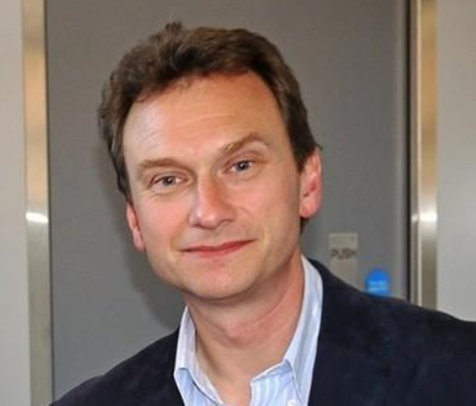
01. ‘Last Horizons: The Solar System beyond Pluto’
Dr. Steph Merritt, ARC QUB.
Conjecture about planet X led to the discovery of Pluto in 1930
Discovery of seven Trans-Neptunian Objects (asteroids) with highly eccentric orbits
Planet X conjectured again: a possible mini-Neptune slowly moving in the direction of Orion.
02. ‘Moving an asteroid – did we do it?’
Prof. Alan Fitzsimmons, ARC QUB.
NASA DART mission: a kinetic impactor spacecraft
Deflect the asteroid Dimorphos which orbits a larger asteroid Didymos
Successful impact and deflection: 27th September 2022
Cone of material ejected from the impact crater to form a dust tail

Slide 3
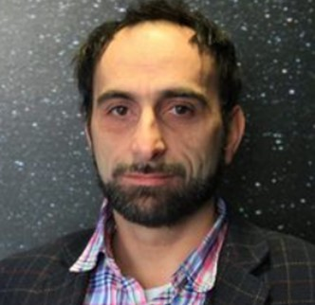
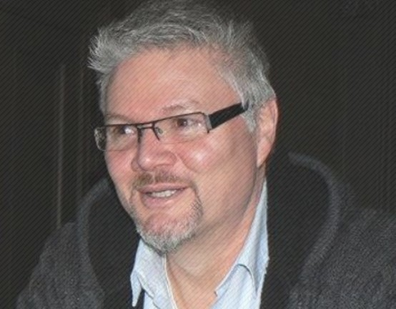
03. ‘Planetary nebulae and their role
in the cosmic distance ladder.’
Prof. Marc Sarzi, AOP.
Luminosity of planetary nebulae can be used as a ‘standard candle’
Planetary nebulae can be observed in galaxies outside the Milky Way
A rough maximum brightness of planetary nebulae allows the distance to the galaxy to be estimated
A step in the cosmic distance ladder to determine the size of the universe
04. ‘A history of Astronomy part 2: from Newton to now.’
Mr. Brian MacGabhann, Galway Astronomy Club.
How we determined:
What stars are
How stars shine
How big the universe is
How the universe came about

Slide 4
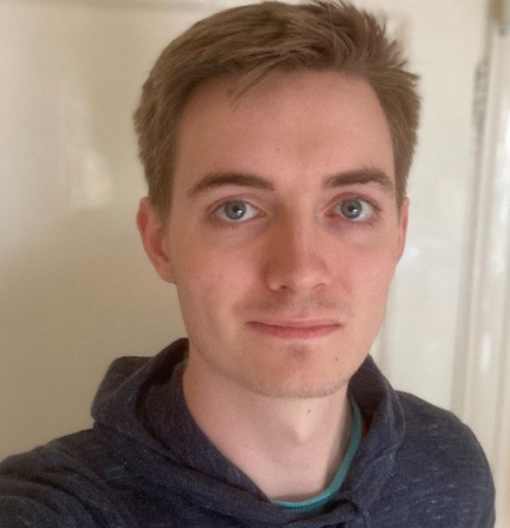
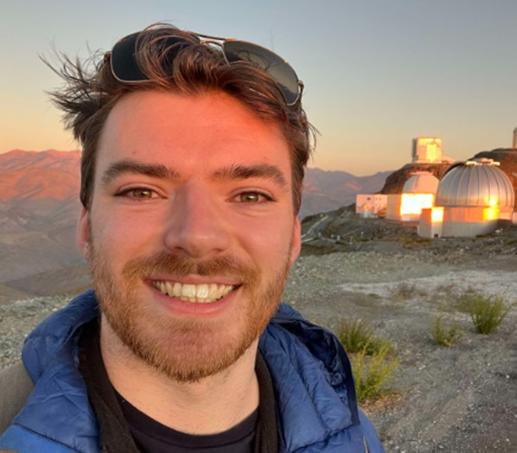
05.a. ‘Hunting for exoplanets using Citizen Science.’
Mr. Sean O’Brien, PhD student, ARC QUB.
Next Generation Transit Survey (NGTS) to detect exoplanets
Public volunteers can get involved in spotting transients in light curves
Find exoplanets missed in initial searches of datasets
05.b. ‘Discovery and characterisation of supernovae in the local universe.’
Mr. Thomas Moore, PhD student, ARC QUB.
ATLAS sky survey used to find stationary transients that may be supernovae
Type 1 (hydrogen poor) supernovae formed from the explosion of white dwarf stars
Type II (hydrogen rich) supernovae formed from the collapse of a massive star
06. ‘First science with the James Webb Space Telescope.’
Prof. Jorick Vink, AOP.
James Webb Space Telescope (JWST) designed to observe in infrared
See back in time to 100 million to 1 billion years after the ‘big bang’
Peer through dust clouds to observe star formation in the early universe
Spectra to identify high redshift proto-galaxies in the very early universe

Slide 5
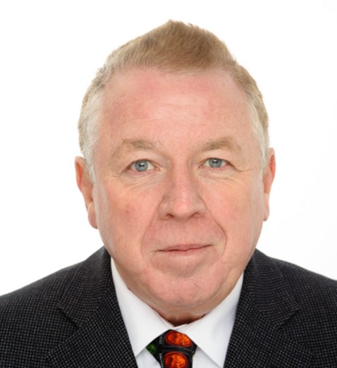
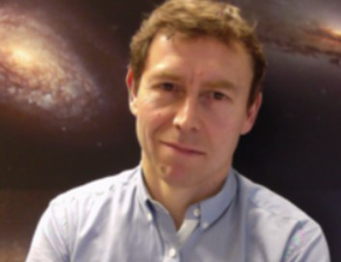
07. ‘Life as a solar/stellar astronomer:
50 telescopes and counting.’
Prof. Emeritus Gerry Doyle, AOP.
Fascinating tour of his time in astronomical research
Used 50 telescopes (and counting) for solar and stellar observations
Applying atomic calculations to solar flare data
Still jointly supervising two PhD students
08. ‘The final fate of massive stars.’
Prof. Stephen Smartt, Oxford University & ARC QUB.
Fate of massive stars (over 20 solar masses) is not clear
The seem to die a ‘dark death’ without a supernova explosion
Leave only a faint infrared trace behind
Implode to form a black hole preventing the outer layers of the star from exploding outwards

Slide 6
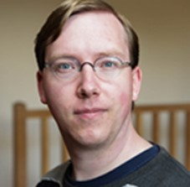
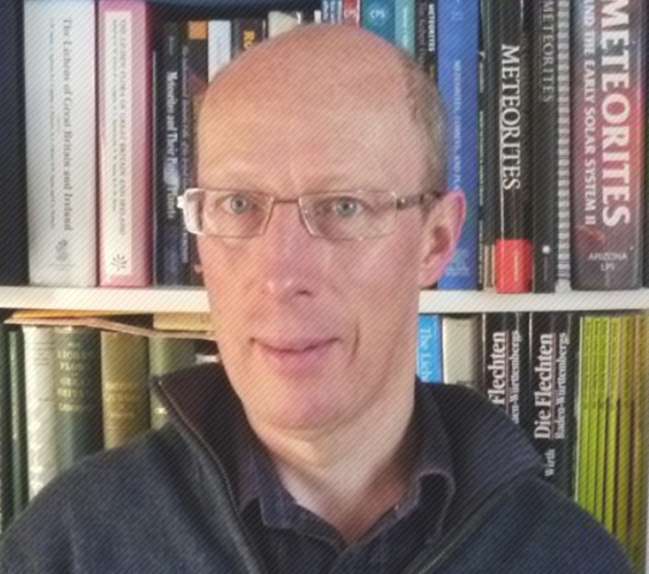
09. ‘Searching for molecules in
the atmospheres of exoplanets.’
Dr. Ernst de Mooij, ARC QUB.
Rotational velocity of exoplanets can be detected by observing blue-shift and red-shift in the planet’s spectrum
JWST can detect CO₂ and H₂O in the atmosphere of ‘hot Jupiter’ exoplanets (gas giants close to the host star)
Generate a temperature map and detect planetary storms on exoplanets
10. ‘The Winchcombe Meteorite 28th Feb 2021: My part in its downfall.’
Dr. Mike Simms, National Museums NI.
Meteorite landed in village of Winchcombe on 28th Feb 2021
CM carbonaceous chondrite (crumbly material made-up of chondrules)
Originally thought to be 13 kg but only 650 g was recovered
Estimated to be 4.6 billion years old and originating in the asteroid belt between Mars and Jupiter

Slide 7
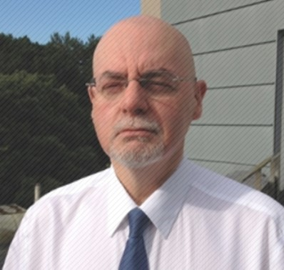
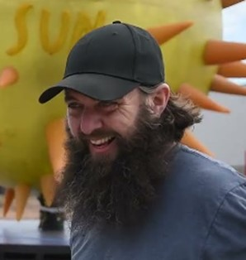
11. ‘The science of superheroes in film and television.’
Prof. Francis Keenan, ARC QUB.
Definitive guided tour of superheroes
Superman, Batman, Wonder Woman, The Incredible Hulk, etc.
Explained how their powers are either technically possible or completely defy the laws of physics
12. ‘Observing solar activity in Lyman-alpha emission.’
Dr. Ryan Milligan, ARC QUB.
Observation of X-class & M-class solar flares in UV Lyman α (1216 Å)
UV radiation has significant effect on Earth: Creation of ozone and D-layer
ESA Solar Orbiter (launched Feb 2020) has a Lyα imager onboard
Make observations inside the orbit of Mercury and outside the ecliptic plane
Allow observation of the solar poles
NASA to launch SNIFS rocket in Alaska in Mar 2024 to make Lyα observations at an altitude of 178 miles

Slide 8
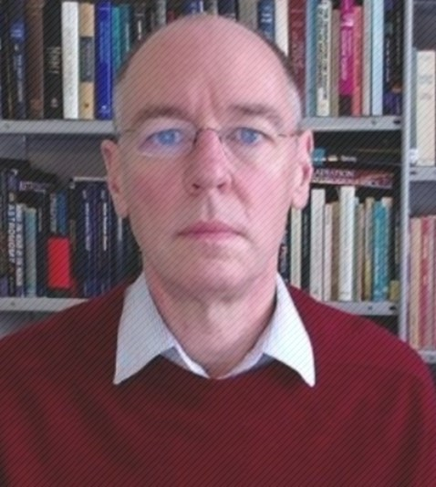
13. ‘Diving deeper into the radio sky: solar, stellar
and extra-galactic astronomy with the LOw Frequency ARray.’
Mr. Jeremy Rigney, PhD student, DIAS & AOP.
Lofar has a baseline of 2000 km and an angular resolution of 0.1” arc
Comprises high and low band antennae fixed in the ground
Used to:
Detect black holes in galactic centres
Survey the sky for new radio galaxies (1 million found so-far)
Showing bright regions of star formation obscured at optical wavelengths, etc
14. ‘SALT and the super-hot zombie stars.’
Dr. Simon Jeffery, AOP.
Over 200 hot O-type stars observed using SALT (Southern African Large Telescope)
Stars with temperatures between 100,000 K and 200,000 K
PG1159 / GW Vir type stars: pulsating variable ‘zombie’ stars formed by late re-ignition of helium fusion and expanding to become yellow supergiant stars
O(He) helium-rich stars which start as a white dwarf binary system which merge to form a yellow supergiant ‘zombie’ star
Zombie stars eventually fade to become DO white dwarf stars

Slide 9
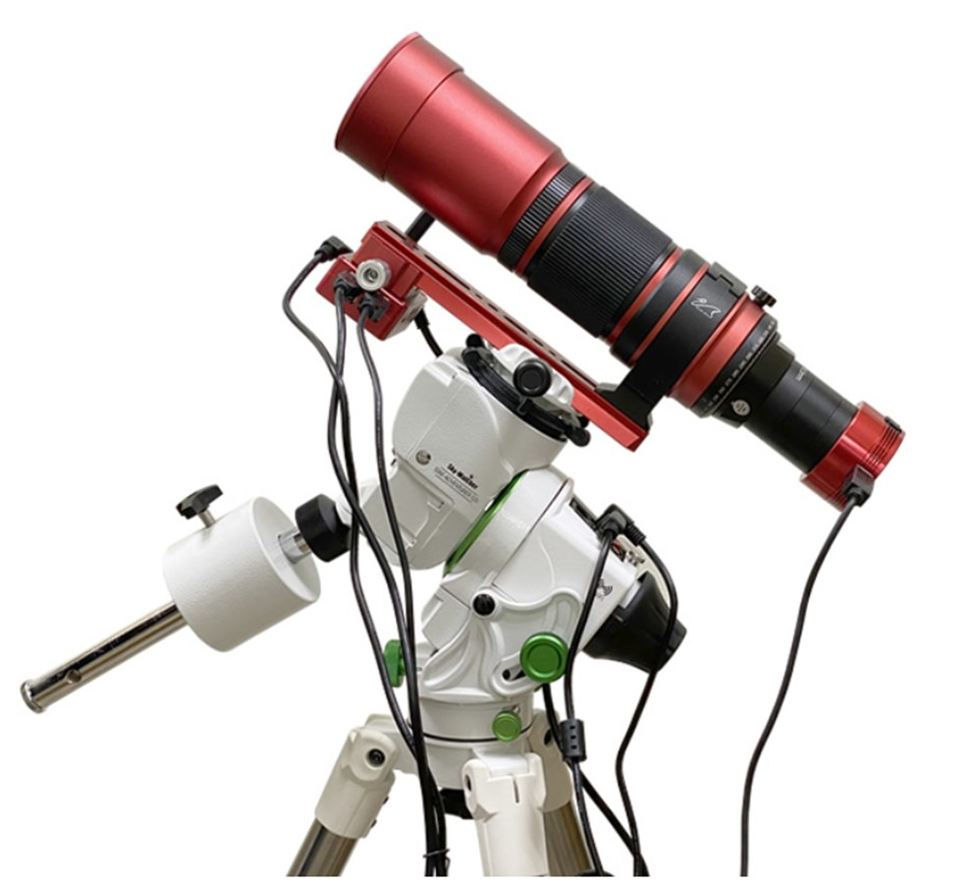
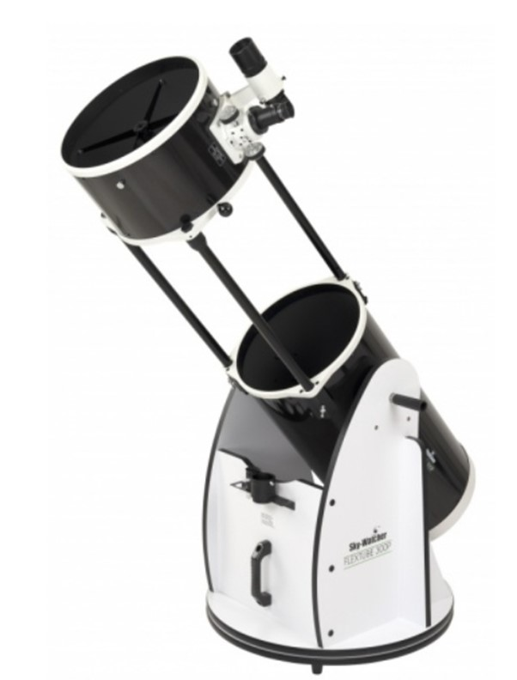
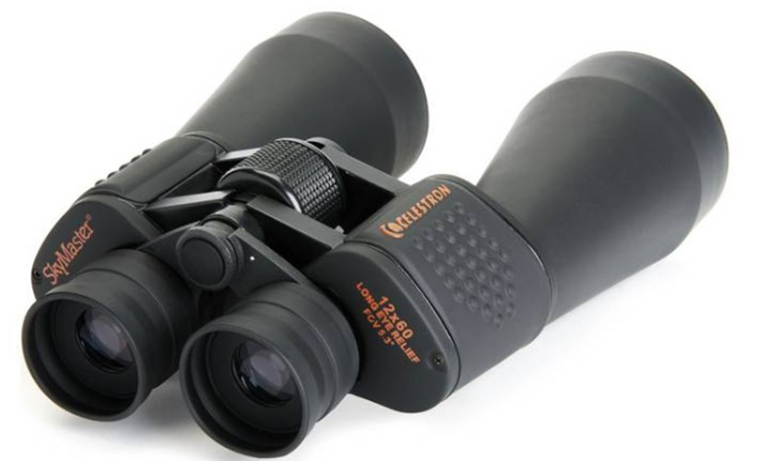
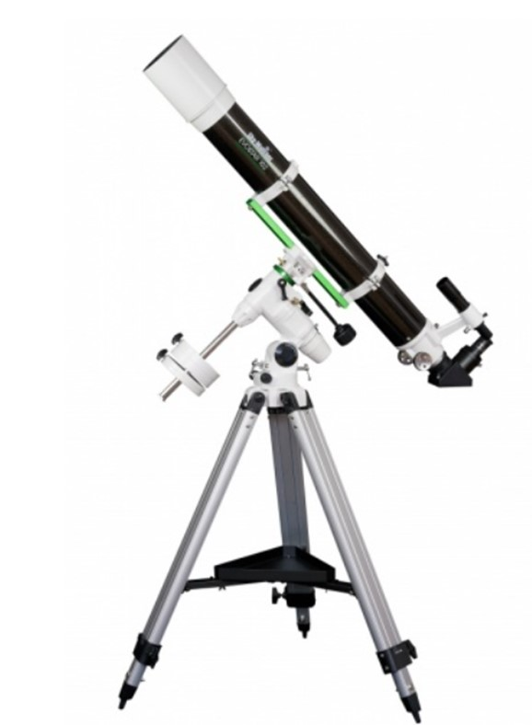
IAA Observing Sessions 2022-23
Date | Venue
16/09/2022 | Delamont Country Park
18/11/2022 | Clandeboye Estate
04/02/2023 | Clandeboye Estate
26/03/2023 | Clandeboye Estate
Objects viewed in these observing sessions included:
M52 Whirlpool galaxy and M22 globular cluster
Jupiter and its Galilean moons
Craters on the Moon
Veil Nebula imaged using Redcat 51 and camera
Thanks to David Stewart the observing section coordinator, Andy McCrea and John McClintock
for organising the observing sessions at Delamont and Clandeboye.

Slide 10
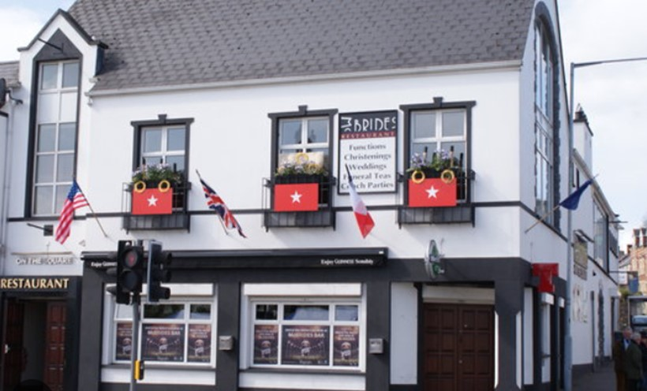
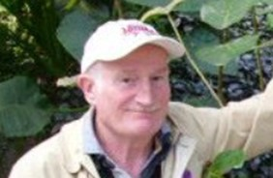
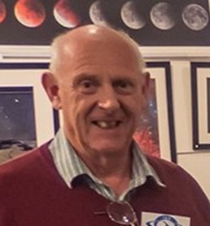
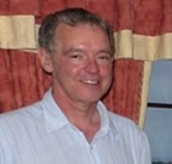
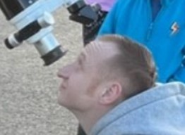
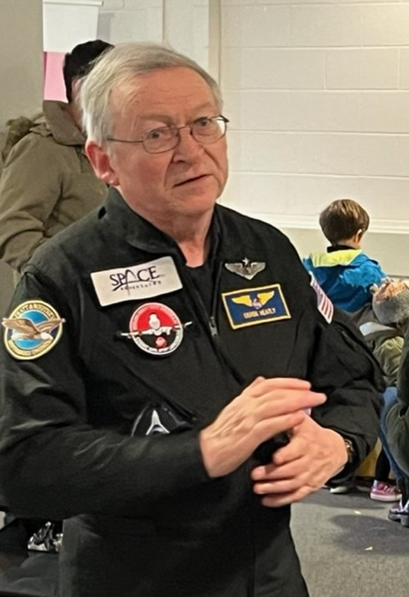
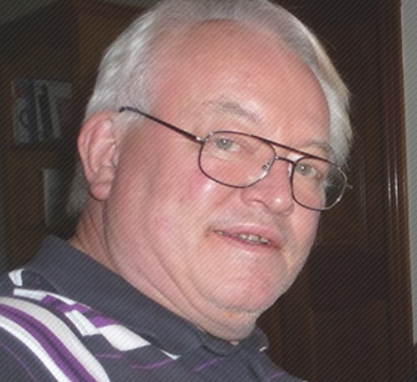
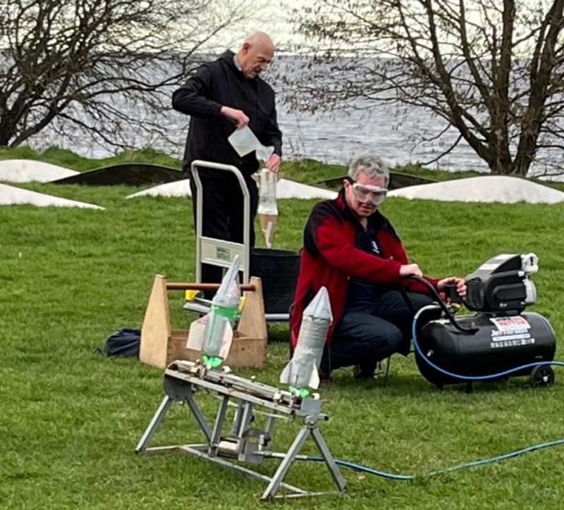
IAA Outreach Events 2022-23
2. Northern Ireland
Science Festival (February 2023)
Rathlin Island
1. New Year Party. (January 2023)
McBride’s on the Square, Comber.
George Brannan’s devilishly difficult table quiz.
3. Northern Ireland
Science Festival (February 2023)
Lough Neagh Discovery Centre.
4. Irish Astronomy Week (March 2023) Paul Evans gave a range of talks:
Neil Armstrong – Moyle Primary School
Introduction to Astrophotography - Armagh Planetarium.
Photographing the Aurora – Larne Camera Club
Introduction to Astronomy – Donegal
Dark Skies Group

